Slide 1
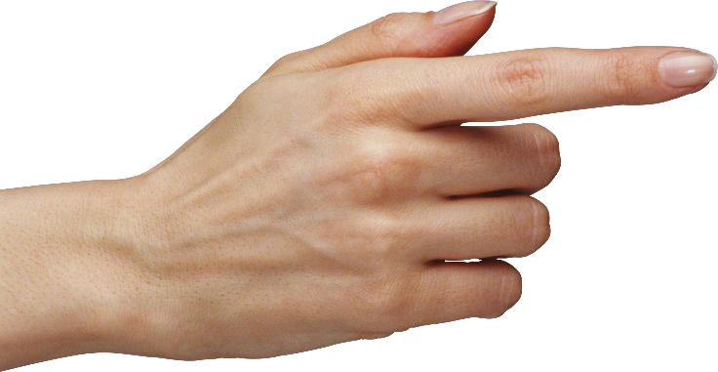
That is
Eevee.
This is Charmander.

Slide 2
a book

Slide 3
a pencil

Slide 4
an eraser

Slide 5
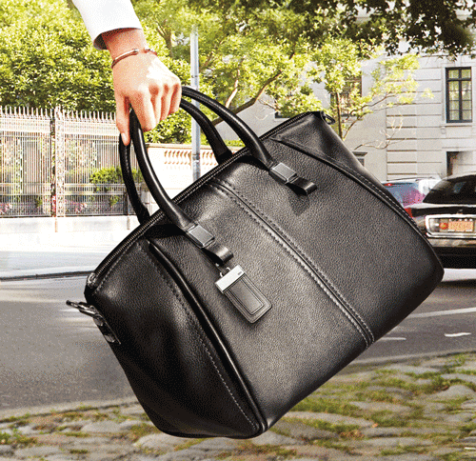
a bag

Slide 6
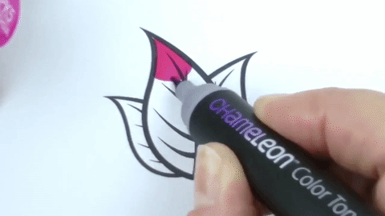
a marker

Slide 7
a ruler

Slide 8
1
2
3
a book
an eraser
a pencil
4
5
6
a bag
a marker
a ruler

Slide 9
What’s this?
What’s that?

Slide 10
This is a banana.

Slide 11
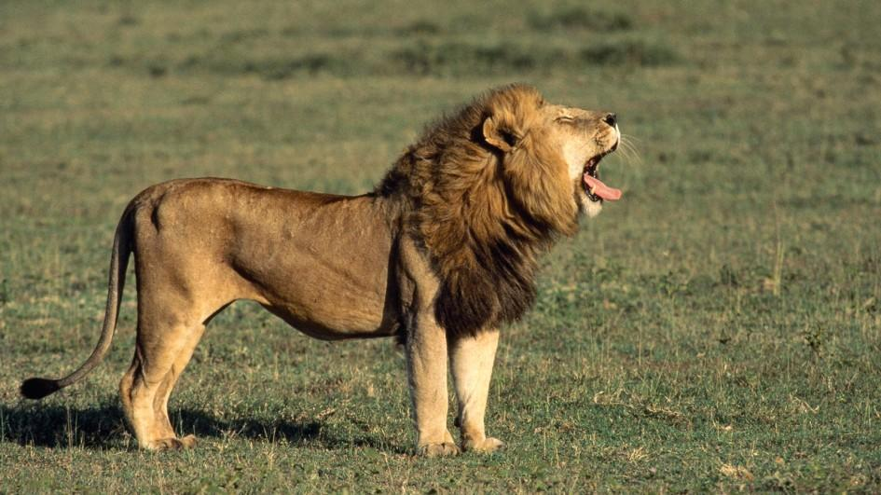
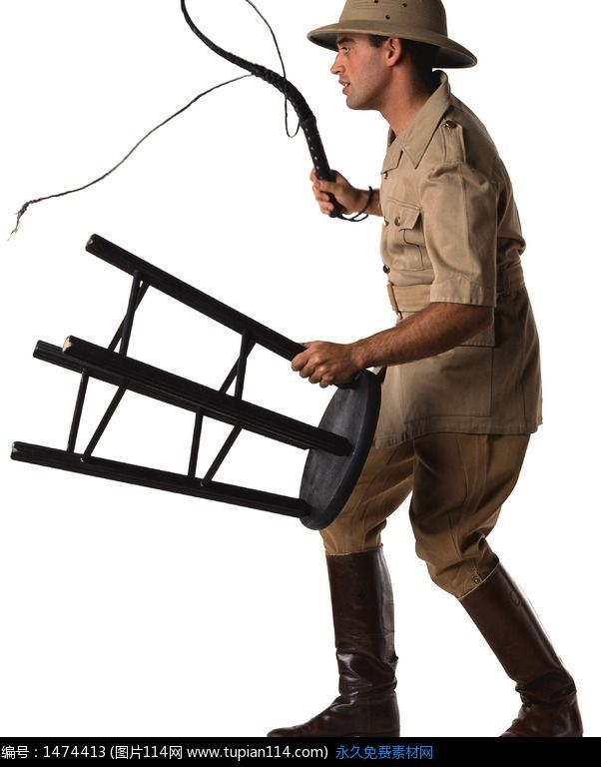
That is a lion.

Slide 12
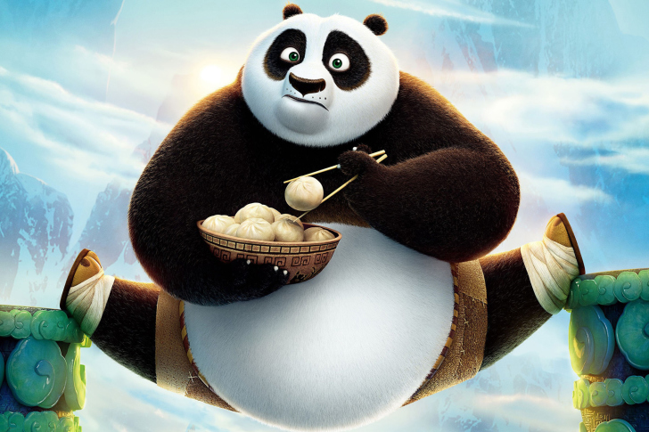
This is a panda.

Slide 13
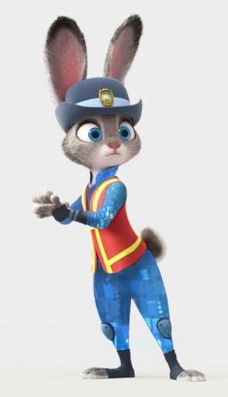
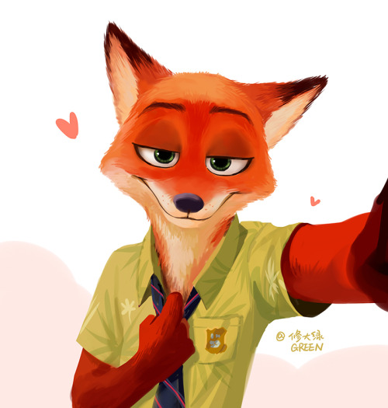
That is a fox.

Slide 14
一次獲得10個印章
進化區點心任選1
進化區用品(文具or玩具)任選1
招式區任選3種小點心

Slide 17
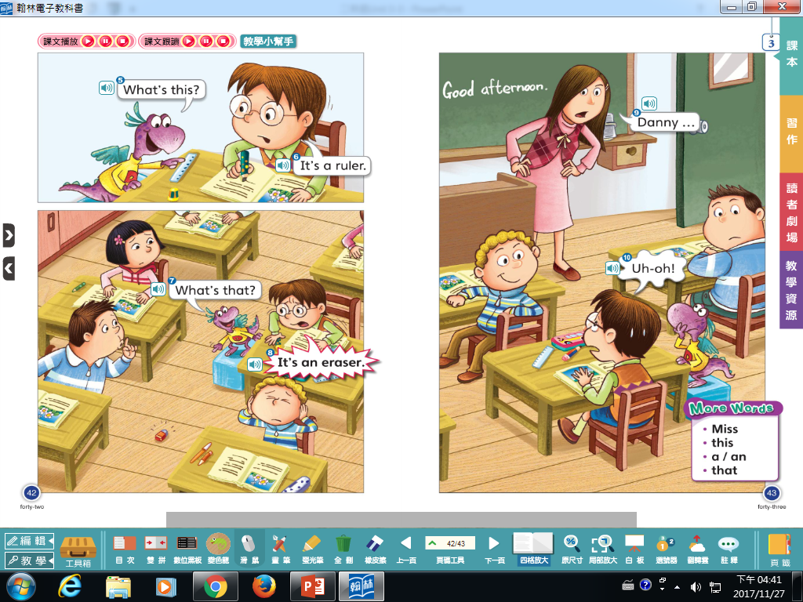

Slide 18
Good morning.

Slide 19
Good afternoon.

Slide 20
跟著Teacher Mandy一起做字母健身操

Slide 21
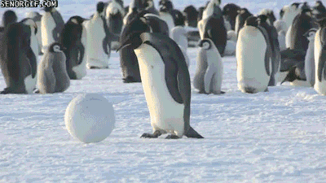
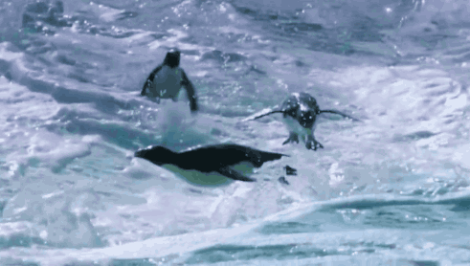
PP pp penguin penguin

Slide 22
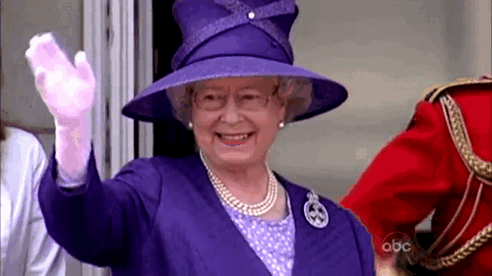
QQ qq queen queen

Slide 23
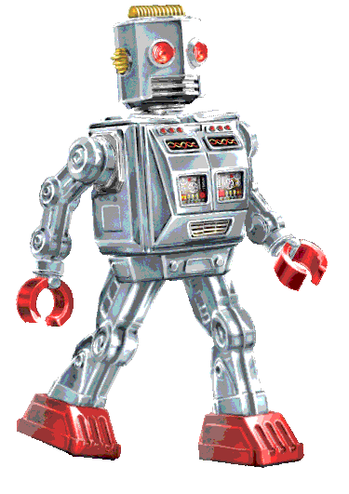
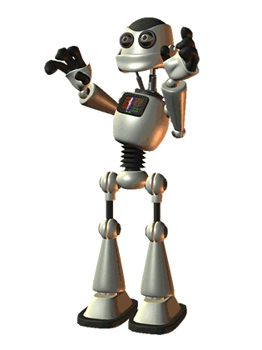
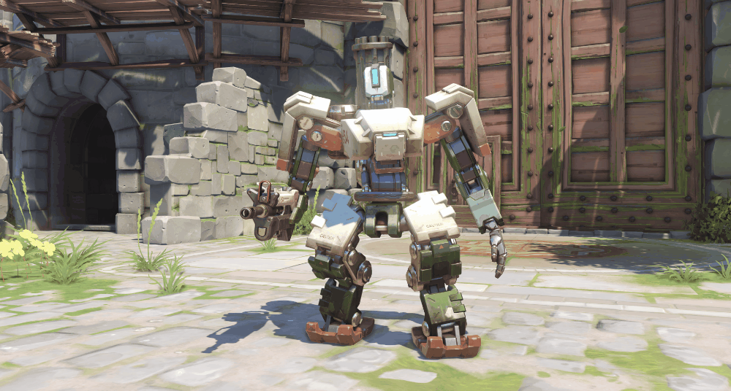
RR rr robot robot

Slide 24
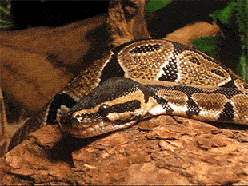
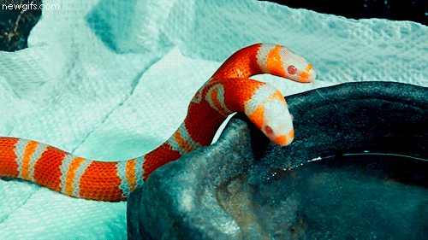
SS ss snake snake

Slide 25
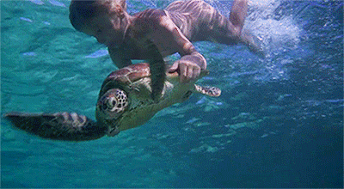
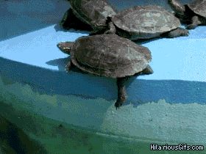
TT tt turtle turtle

Slide 26
Let’s take a review.!

Slide 27
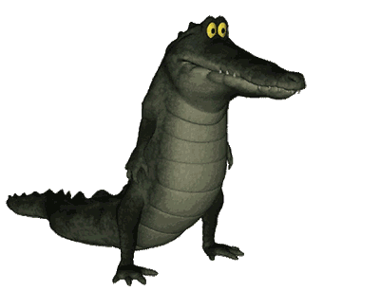
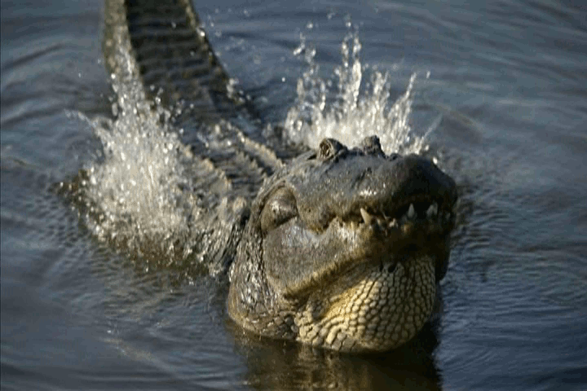
AA aa alligator alligator

Slide 28
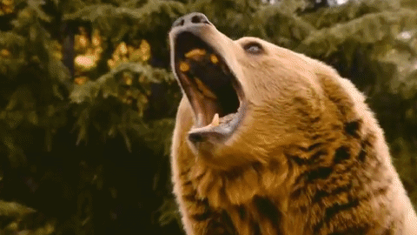
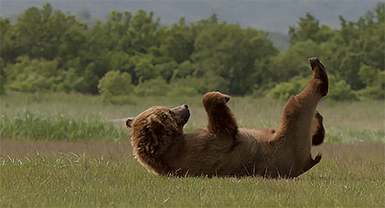
BB bb brown bear brown bear

Slide 29
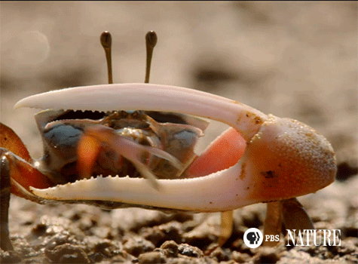
CC cc crab crab

Slide 30
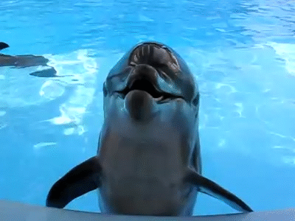
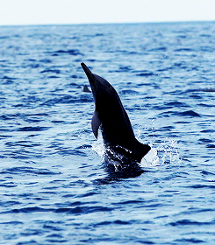
DD dd dolphin dolphin

Slide 31
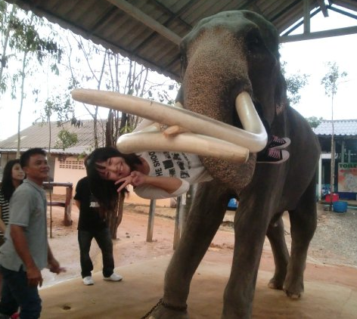
EE ee elephant elephant

Slide 32
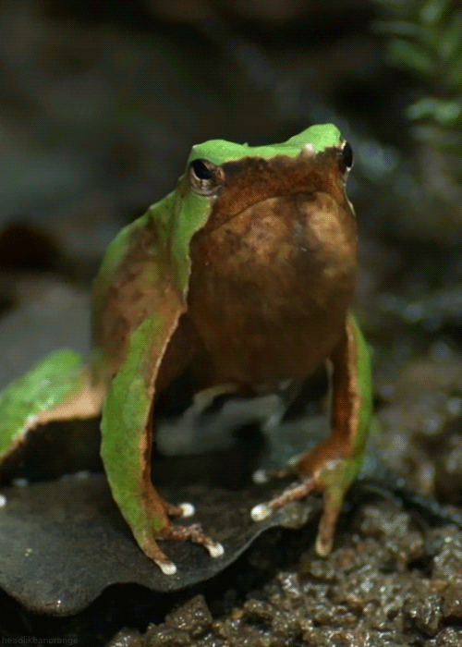
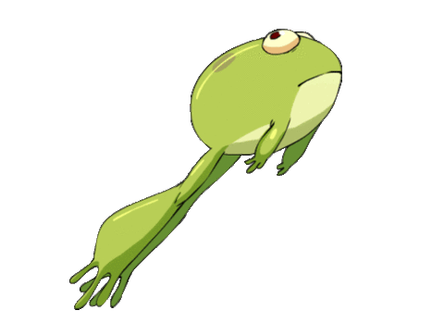
FF ff frog frog

Slide 33
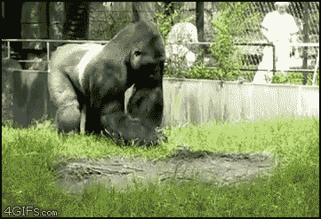
GG gg gorilla gorilla

Slide 34
HH hh hula hoop hula hoop

Slide 35
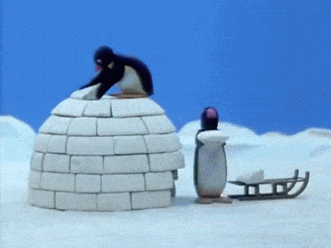
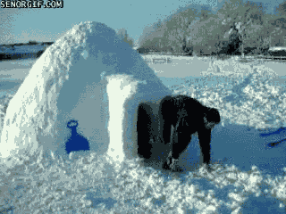
II ii igloo igloo

Slide 36
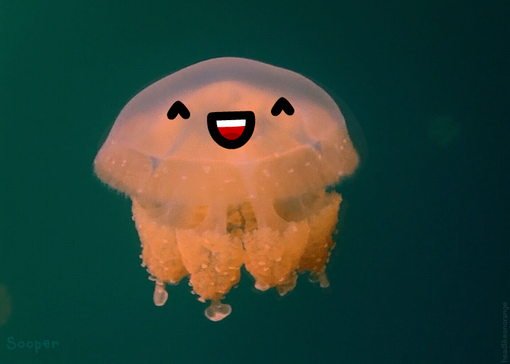
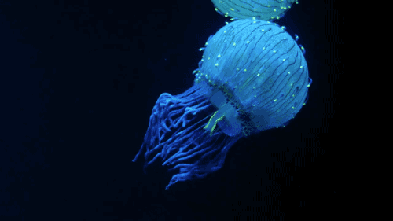
JJ jj jelly fish jelly fish

Slide 37
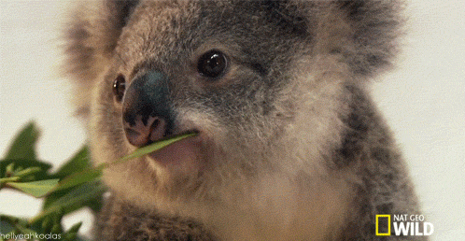
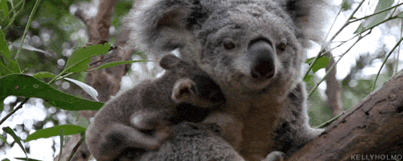
KK kk koala koala

Slide 38
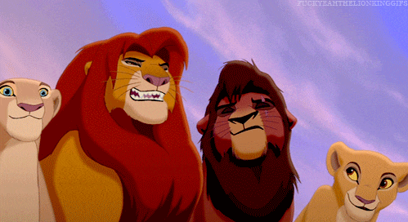
LL ll lion lion

Slide 39
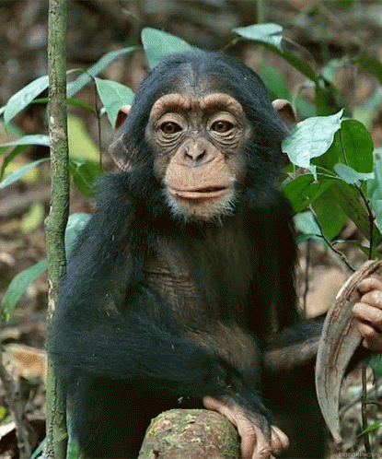
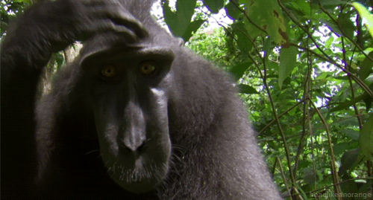
MM mm monkey monkey

Slide 40
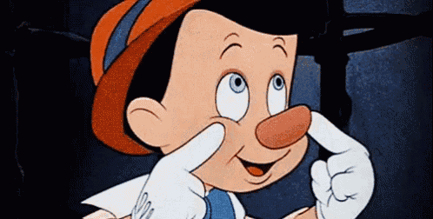
NN nn nose nose

Slide 41
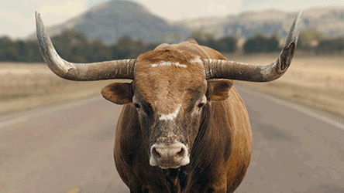
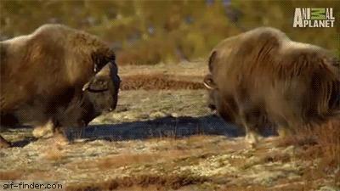
OO oo ox ox

